Slide 1
Career Research in the Exploratory Program
SKILLS LIBRARY DATABASE Exploratory Guide

Slide 2
Background: How to talk about career paths

Slide 3
During Exploratory
During the Exploratory program, students should feel confident that any of their choices will open up lots of varied opportunities.

Slide 4
A straight line from school/training to career
Other careers follow a unique path, with a variety of jobs over time, using the same skills and interests in a variety of settings.
Some careers follow a fairly simple straight line, from school and training to entry-level jobs in the chosen career field to higher-level jobs within that field.
Or a less-direct path
A career path could be described as a straight line, a ladder, a lattice, a mosaic, or other descriptions…

Slide 5
In Every CVTE Program …
AND …
Every CVTE program provides students with skills that will open doors to a variety of career paths.
Every CVTE program provides students with skills, knowledge and credentials that open up opportunities in specific careers.

Slide 6
Introducing Career Information – Discovery Phase

Slide 7
Introducing Career Information
During the Discovery phase of the Exploratory program, teachers will describe a few of the most common first steps after graduating from the program….
Students can go to work as _______, ________, or __________.
Students can enter apprenticeships through _____________.
Students can go on to college or career training programs focusing on ___________.
… And will also describe a few examples illustrating a wide range of career paths, such as unique job settings, or self-employment, or jobs using emerging technologies.
Teachers can provide statistics about at least one of the job titles in this field, including a job description, entry requirements, types of companies or organizations hiring, salary range for entry-level, average and most-experienced workers. Classrooms may also have posters with career information about a variety of career options.

Slide 8
Where to find career profiles ….
Naviance
MassHire 360 (formerly MassCIS):
https://portal.ma.cis360.org/
Occupational Outlook Handbook / Bureau of Labor Statistics: https://www.bls.gov/ooh
+ Websites of unions and professional organizations
+ Plus a variety of other websites

Slide 9
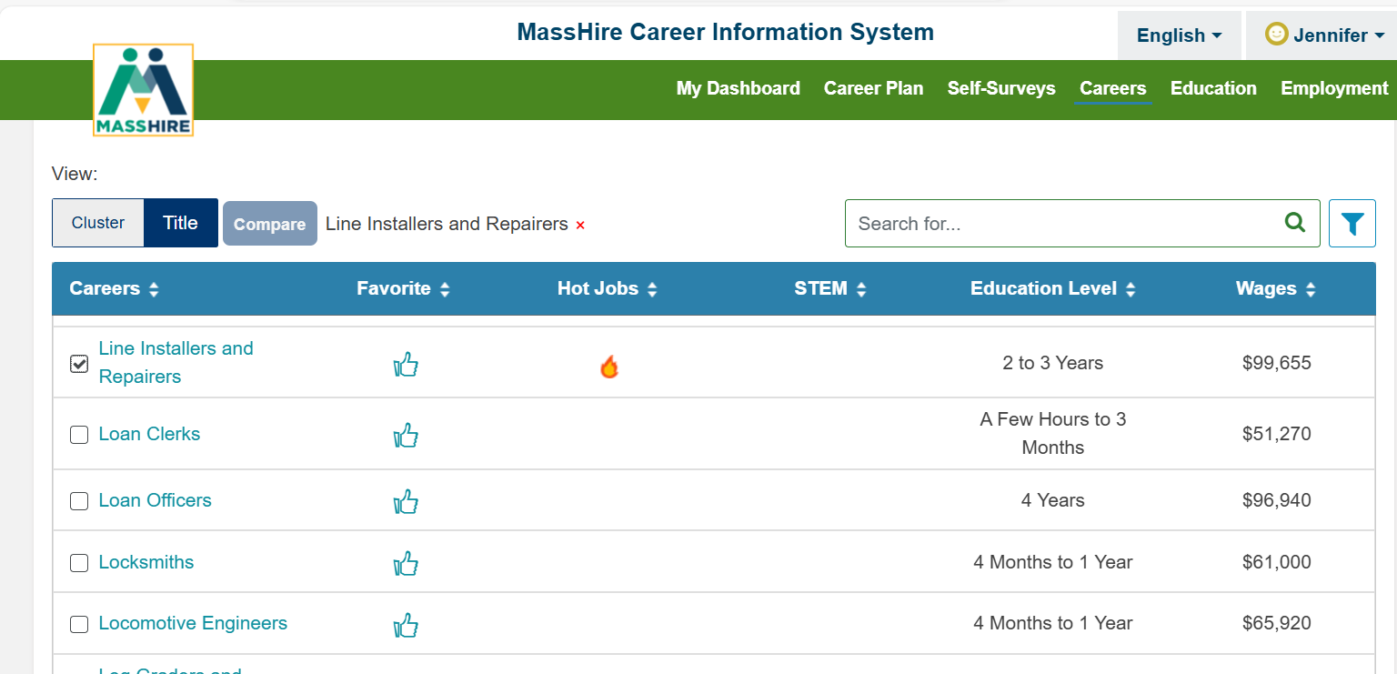
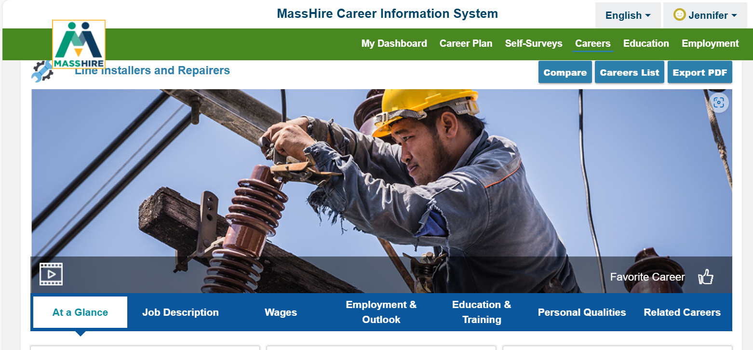
Sample screen from MassHire 360

Slide 10
…. Combined with your local knowledge
Combine the formal career profile with your own local knowledge:
Examples of local companies and organizations, especially those that have hired co-op students or recent graduates; or who have provided field trips, joined the Program Advisory Board, or other connections with the school.
Examples from friends and former colleagues of interesting career paths within your industry.

Slide 11
How to put salary information in perspective
Provide perspective about the range of possible paths and earnings.
While some careers have a fairly well-defined career path, others are more varied, with a wide range of possible earnings.
In your field, what are the factors that affect earnings? For example, do people earn more if they are self-employed? Or if working for a larger organization or company? Or if they have specific skills or credentials?
Is there a range of paths that includes high profile but harder-to-enter roles (such as movie director, top fashion designer, etc.) as well as a variety of more accessible paths? How can students realistically think about these options?
Are there trade-offs between earnings and other career values? For example, some jobs pay above-average earnings because of more demanding working conditions or travel requirements; while others may pay less but offer some non-tangible benefits.
Notes:
Make the point that workers in the Boston area tend to earn more than those in other parts of the state, and so national or statewide statistics may be a bit lower than what a worker in Boston can expect. Also make the point that wages and salaries rise year-by-year, and so statistics from even a year ago may be a bit lower than current figures.
Provide perspective when describing an annual salary. How much is that per hour? Per week? How does that compare to median incomes in the Boston area (being sure to distinguish household vs. individual incomes)? How does that compare to average apartment rents? How does it compare to the household income needed for a mortgage for a typical starter home in Boston?
Provide perspective about the range of possible paths and earnings. While some careers have a fairly well-defined career path, others are more varied. In your field, what are the factors that affect earnings… for example, do people earn more if they are self-employed? Or if working for a larger organization or company? Or if they have specific skills or credentials? Etc.

Slide 12
How to put salary and cost of living in perspective
Make the point that Massachusetts Is one of the most expensive states in the country, and Boston is one of the most expensive cities. Especially in the downtown neighborhoods, people working in fields such as high tech, law, medicine and finance tend to earn very high salaries and pay very high housing prices. This bubble of wealth, high salaries and high housing costs makes it hard to analyze Boston data to see “what is a good salary in Boston.”
For perspective, it is helpful to look at average salaries and household income by age group, neighborhood, and to look at national as well as local statistics.

Slide 13
For perspective: Median Earnings By Age in the U.S.
Median Earnings by Age in the United States
Source: U.S. Bureau of Labor Statistics
Age | Weekly Earnings | Annual Wage | Average Hourly Wage
16 to 19 years old | $611 | $31,772 | $15.28
20 to 24 years old | $737 | $38,324 | $18.43
25 to 34 years old | $1,018 | $52,936 | $25.45
35 to 44 years old | $1,223 | $63,596 | $30.58
45 to 54 years old | $1,239 | $64,428 | $30.98
55 to 64 years old | $1,218 | $63,336 | $30.45
65 years and older | $1,042 | $54,184 | $26.05
Source: Average Salary by Age In 2024 – Forbes Advisor

Slide 14
For perspective: Median Household Income (Household => may include more than one earner)
Zip Code | Neighborhood | Population | Number of Households | Median Household Income
02119 | Roxbury | 26,821 | 11,823 | $37,158.00
02120 | Roxbury Crossing (Mission Hill) | 14,364 | 4,584 | $51,698.00
02121 | Dorchester (Grove Hall) | 29,820 | 10,513 | $42,411.00
02122 | Dorchester | 24,705 | 9,449 | $81,025.00
02124 | Dorchester | 55,336 | 19,166 | $72,189.00
02125 | Dorchester (Uphams Corner) | 31,903 | 13,284 | $64,983.00
02130 | Jamaica Plain | 41,479 | 17,922 | $114,933.00
Source: Boston, MA Household Income, Population & Demographics | Point2 (point2homes.com)

Slide 15
Exploring Career Information – Exploration Phase

Slide 16
Researching, reflecting & asking questions
In the second phase of the Exploratory program, students will take a greater role in researching, reflecting and asking questions about career options.

Slide 17
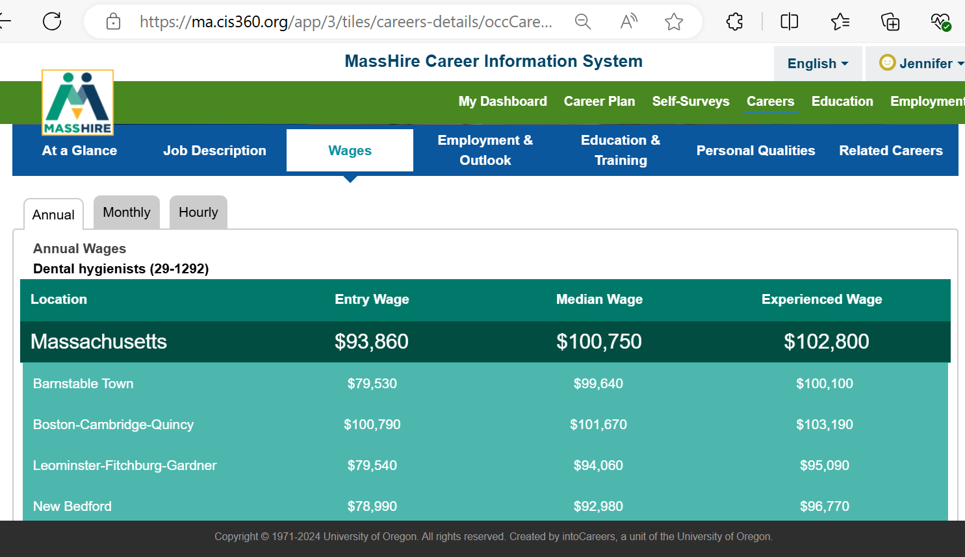
Researching, reflecting & asking questions
ONLINE CAREER RESEARCH: Ask students to use online sources to gather information about job titles, salary ranges, and typical entry requirements, and create a chart, poster, or slide presentation about what they learned. Provide a list of job titles, a template with key questions, and a list of recommended websites to help students get started on this project.

Slide 18
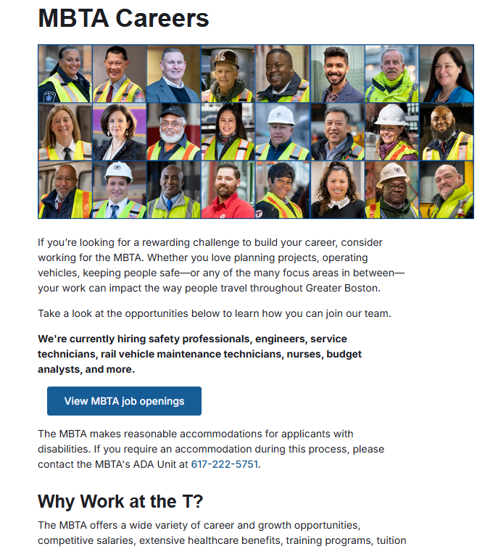
Researching, reflecting & asking questions
ONLINE COMPANY RESEARCH: Ask students to use company websites to create profiles of local companies and organizations that employ people in this career field. For example, in the health field, students might profile a home health care agency, a hospital, or a community health center. Students summarize their findings with a chart or poster and share their findings with the class.

Slide 19
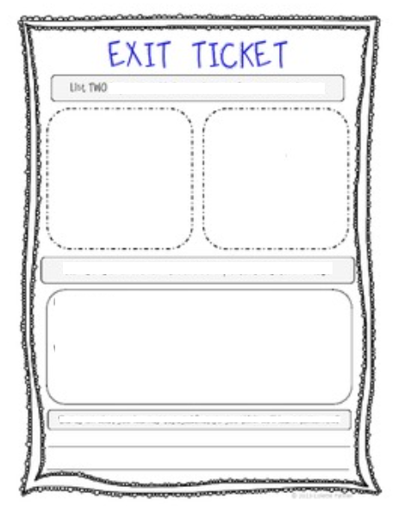
Researching, reflecting & asking questions
DO NOW / EXIT TICKET EXERCISES: As an opening or closing exercise, ask students to make a list or write some questions, such as:
~ List three or more job titles related to this program:
~ Write three questions about future careers related to this program:
~ List three local companies or organizations that employ people in this career field:

Slide 20
Researching, reflecting & asking questions
REFLECT ON CONNECTIONS TO CAREER VALUES / INTERESTS:
Students will complete a career assessment (i.e., Holland Codes) near the end of the Discovery phase (Phase 1) of Exploratory.
In the Exploration phase (Phase 2) ask students to think about how careers in this program connect to career interests and values that they have identified. Encourage students to think out-of-the-box, such as seeing the artistic aspects of fields not traditionally described as artistic, or the helping aspects of fields not traditionally described as helping careers.

Slide 21
Describe opportunities during high school
Describe opportunities that students will have during high school, including internship and co-op options, Skills USA, industry-recognized credentials, special projects and events, or other opportunities. Provide visuals within the classroom– posters, photos, etc. – to highlight these opportunities.

Slide 22
Researching, reflecting & asking questions
CONNECT WITH FAMILY:
Ask students to talk to family members about this career:
- Do we know anyone in our extended family or network of family and friends who works in this career field ?
What are your thoughts about this career field ?
Do you have any questions that I should ask about this career field ?

