Slide 1
Exploratory Teacher and Student Screens
Skills Library Database
Fall 2024
For technical assistance:
Jennifer Leonard | jleonard@skillslibrary.com| Phone/Text: 781-321-7894

Slide 2
QUICK REFERENCE
FOR ANY TEACHER / STAFF:
Find today’s schedule for any student:
https://skillslibrary-dr.com/scheduletoday.asp
Master Schedule (By Rotation Group)
https://skillslibrary-dr.com/phase1rotations.asp
Calendar
https://skillslibrary-dr.com/expcalendar.asp
THESE REFERENCE SCREENS + MORE ARE ALSO AVAILABLE WHEN YOU SIGN IN TO THE SKILLS LIBRARY:
https://skillslibrary-dr.com
STUDENT SCREENS: Use link that is emailed to each student or sign in with student name & email at skillsdr.me

Slide 3
Exploratory Student Screens
Skills Library Database
Fall 2024

Slide 4
Before the first exploratory week begins, students receive an email telling them that the exploratory program is beginning, with a brief overview plus:
the name of their first class;
a personalized link to the student screens

Slide 5
Students will receive an email each day with their rotation schedule for the day; throughout both phases of the Exploratory program., and with the link to sign in to see their schedule and complete their online reflection journal entries.
The email will come from exploratory@skillslibrary-dr.com
Students can find all of the information they need and complete their journal assignments in the student screens.

Slide 6
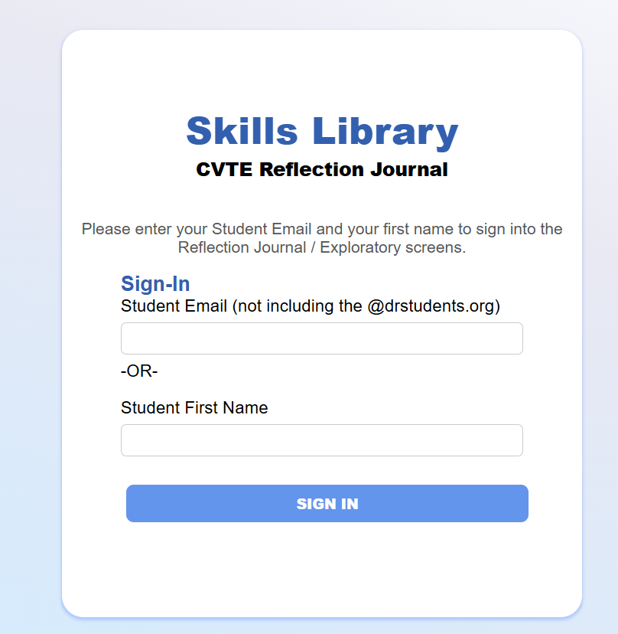
The individualized link bring students to a home page (see next slide) or the link brings students to this sign-in screen
Students initially sign in with their name and email or ID, and later set their own password.

Slide 7
For a sample student screen, sign in with Sample@skillslibrary-dr.com and the firstname Sample.
sample@skillslibrary-dr.com
Sample

Slide 8
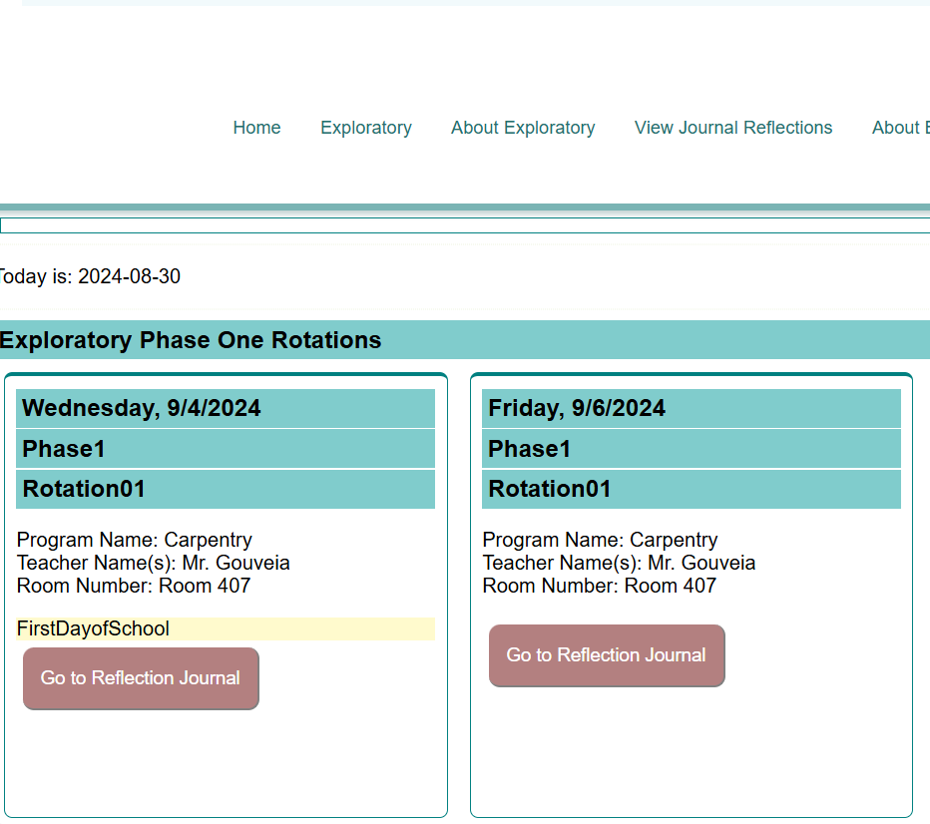
The student screens includes the student’s personalized schedule. For each day of the program, they see the date, time, program name, teacher name(s) and the room number and floor.
From the signin page and dashboard, students click EXPLORATORY to see their schedules.

Slide 9
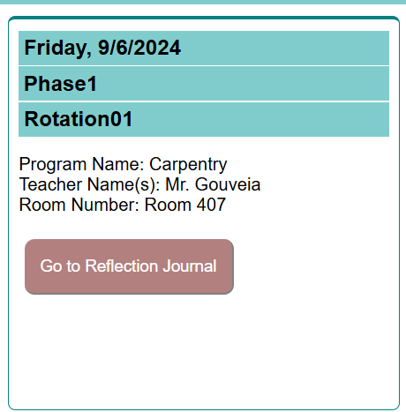
Students will write a brief reflection journal entry for each session.
Students earn exploratory points for completing these entries.
Once an entry is completed, a checkmark will appear next to the button..

Slide 10
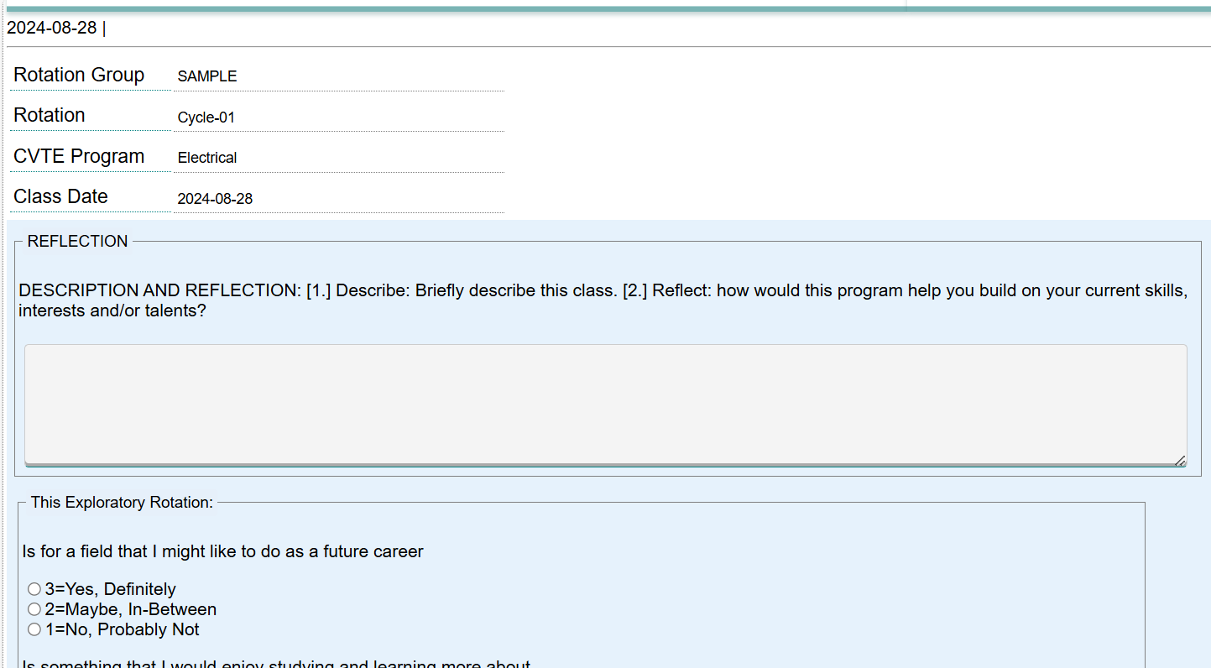
This is the reflection screen. Students write and SAVE their reflections for each session.

Slide 11
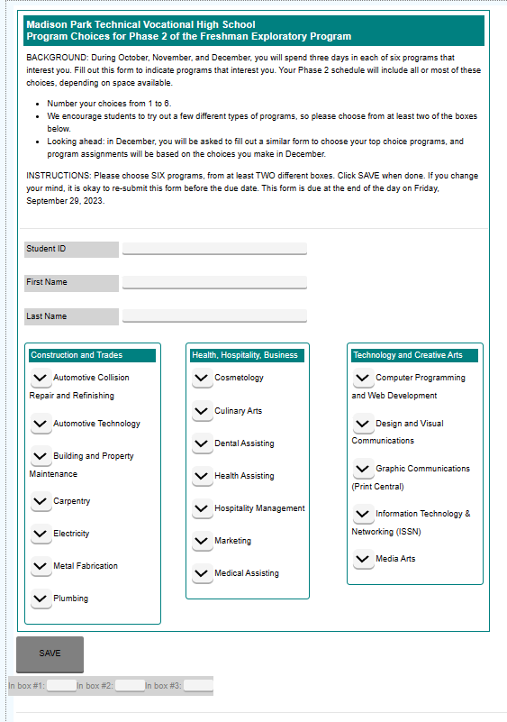
Later in the Exploratory program, students will use the Exploratory screens to fill in program choice forms, career interest exercises, surveys or other items.

Slide 12
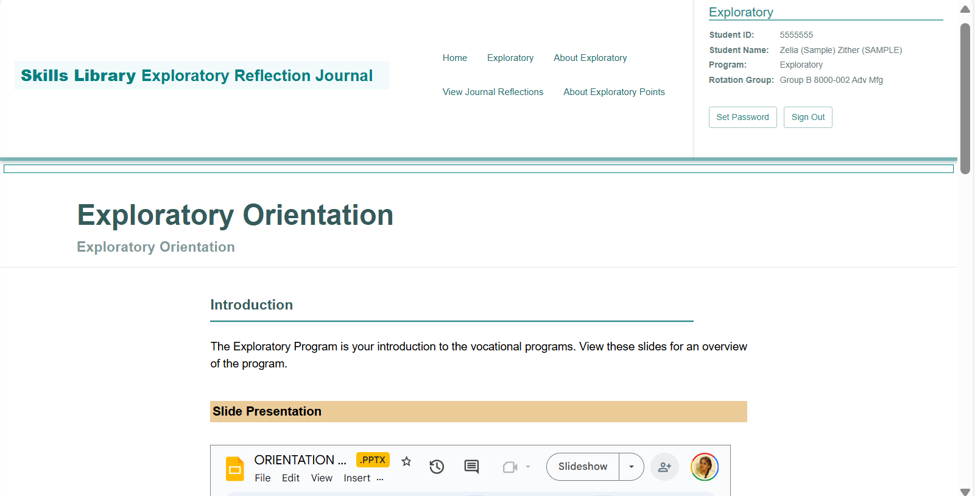
Students can view other items as well, including:
My exploratory score
All of my reflection journal entries
Exploratory Orientation slide show and notes about the Exploratory program
Other items as needed…

Slide 13
… for example, a survey with this career values and interests survey question …

Slide 14
Exploratory Teacher Screens
Skills Library Database
Fall 2024

Slide 15
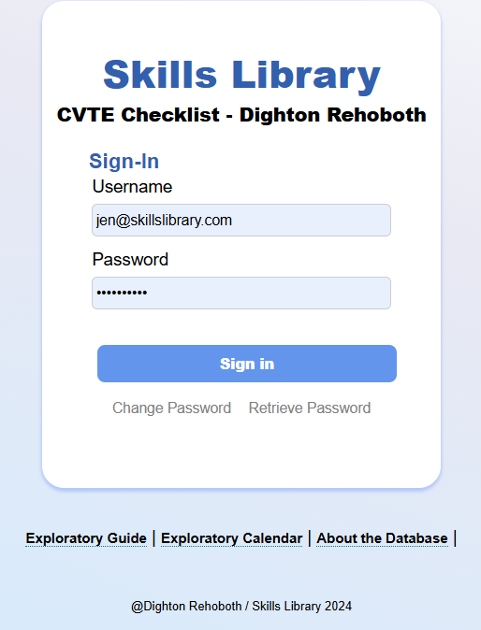
Sign into the Skills Library database at https://skillsibrary-dr.com
Email Jennifer Leonard at jleonard@skillslibrary.com or your program director/coordinator for a username and password.
Please include your name, email, and the name of your CTE program.

Slide 16
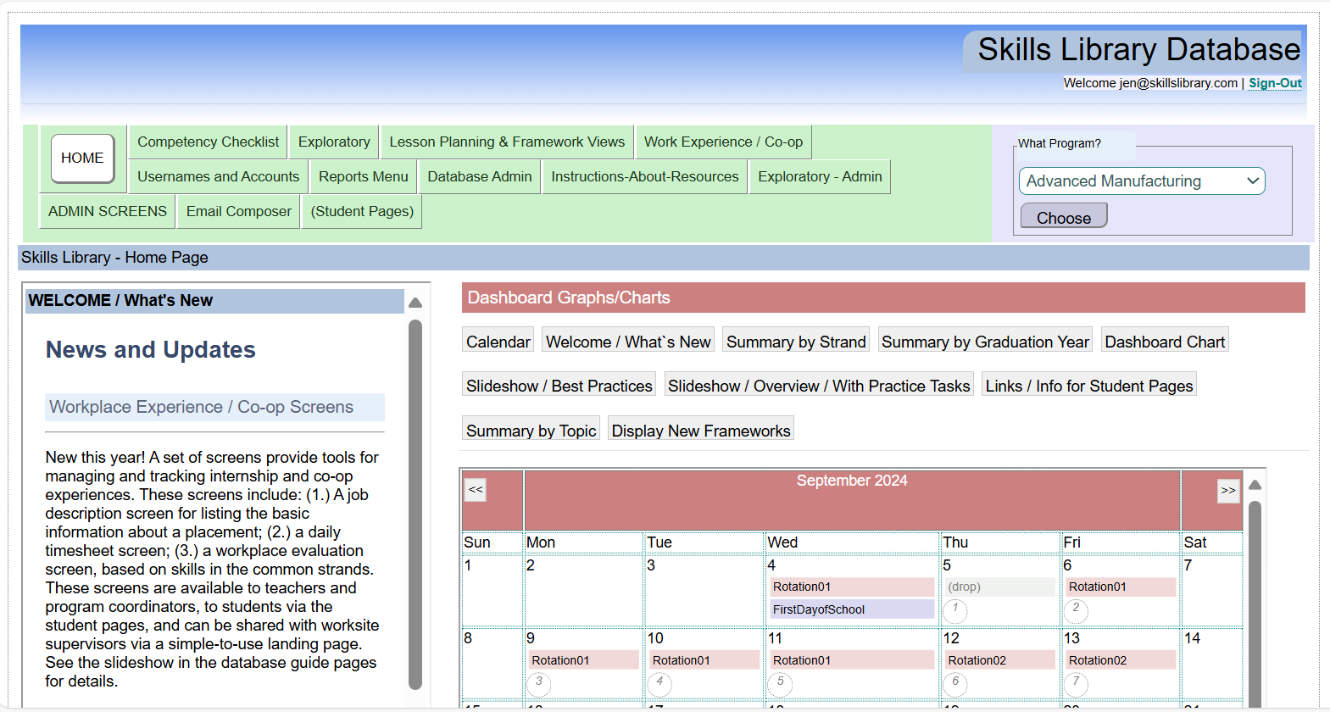
The exploratory calendar and other features appear on the home page.
All of the Exploratory screens are found under the tab “Exploratory” on the navigation bar along the top.

Slide 17
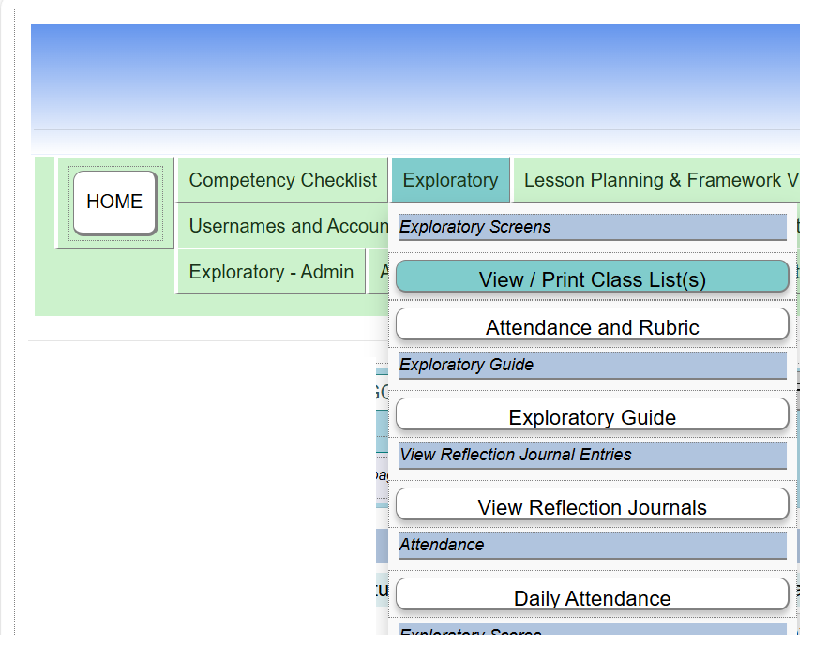
Under the Exploratory tab, find the options to print class lists or to complete the Attendance and Rubric screen.

Slide 18
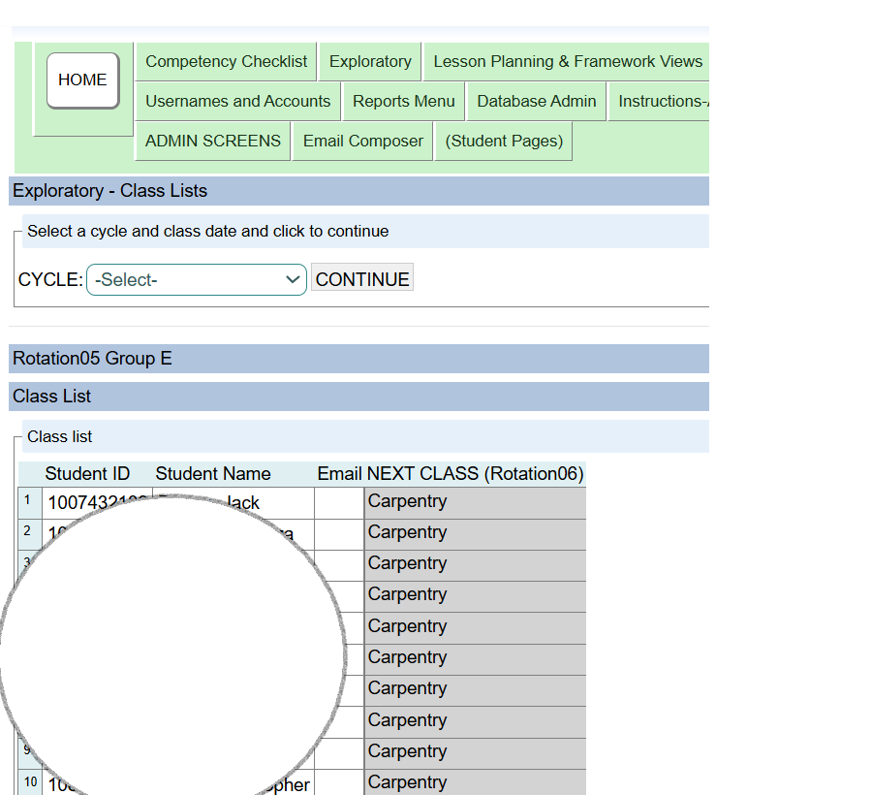
On the class list screen, choose a ROTATION and click to CONTINUE…
The class list provides a list of students, plus a column showing the next rotation .

Slide 19
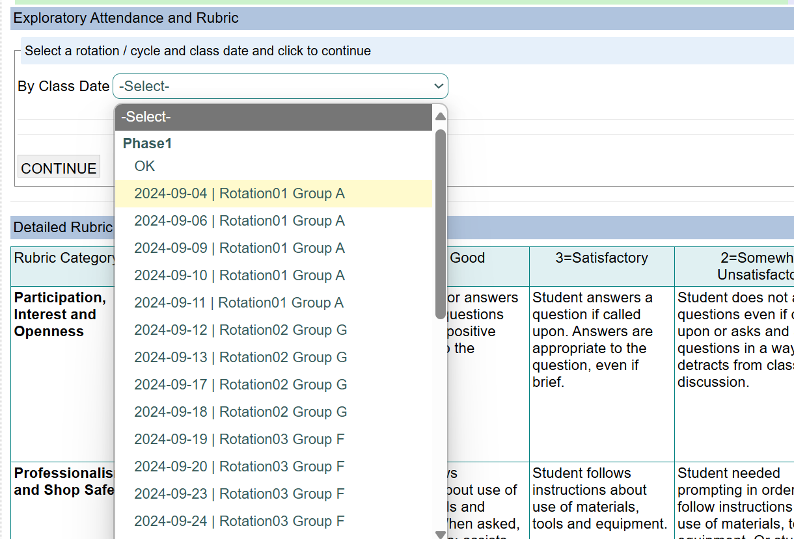
On the attendance and rubric screen, choose a DATE and Rotation and click to CONTINUE.
Notice:
Today’s date is highlighted in yellow.
Dates that have been data entered have a checkmark next to the date

Slide 20
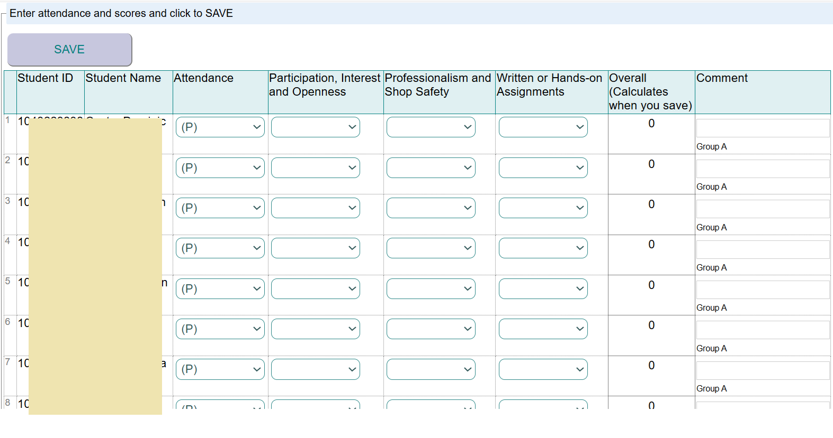
This is the screen for entering attendance and scores. Student names appear along the right, and there are columns for the Attendance and for the scores in the different rubric categories.

Slide 21
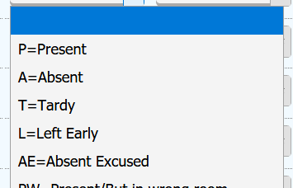
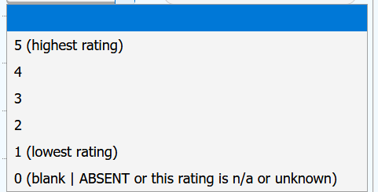
The attendance column has a dropdown with codes including P for Present, A for Absent, T for Tardy, L for Left Early,and other options.
The rubric columns have a dropdown list with a 1-5 scale, with 5 as the best score. Leave blank (or zero) if the student was absent or if an item is not applicable or unknown. Zeroes will not count in the final exploratory scores.

Slide 22
ALSO:
Look under the Exploratory tab for summaries of the Reflection Journal entries, Attendance, and other data.
For Administrators:
Look under the Exploratory – Admin tab for screens for editing the calendar, managing class lists, and other tasks.

