Slide 1

Vocational Exploratory Program
2024-2025 School Year

Slide 2
Program Overview

Slide 3
Freshman Vocational Exploratory Program
Phase 1
Students rotate as a group, and spend a few days in each program
============
At the end of this phase, students fill out a choice sheet to select programs that they would like to explore further..
Phase 2
Students have individualized schedules based on their top choices.
========
At the end of this phase, students fill out another choice sheet to select their top choices. Students are invited to join a program, based on choices, space available and points earned.

Slide 4

Each day, you will receive an email telling you what shop you are attending, which will include a brief overview with:
the name and room number for your shop; and
a personalized link to the Skills Library student screens where you can see your schedule and write reflections.

Slide 5
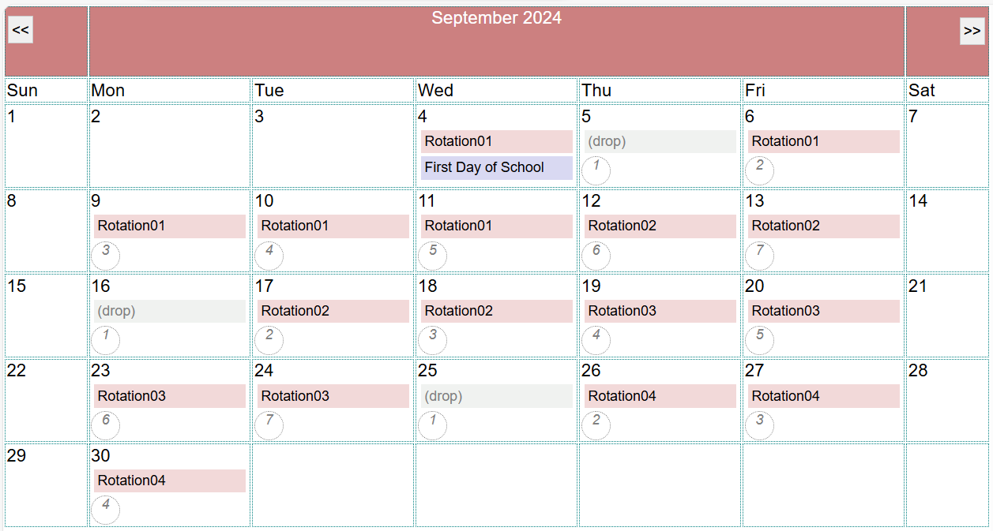
Exploratory Calendar
You will receive an email letting you know what shop you have each day, along with the Exploratory calendar showing the dates for each cycle.

Slide 6
Advice for Getting Started

Slide 7


Advice for Getting Started
During Exploratory: You will earn exploratory points for the work you do during the exploratory program. Your score will reflect:
~ your positive participation,
~ your hands-on and written work; and
~ professionalism and attention to safety.
The more points you earn, the better your chances of getting a spot in one of your top-choice programs.

Slide 8

Advice for Getting Started
Safety: During the program, you will be able to work with some of the tools, equipment and materials used in each shop. Your instructor will explain all important safety guidelines that must be followed.

Slide 9

Advice for Getting Started
MAKING CHOICES: All students who graduate from CTE programs follow a wide variety of career paths, sometimes following a straight-line path to a career based on their CTE program and sometimes using those same skills in a variety of different ways.
During the program, you will think about your short-term and long-term interests, about what you will enjoy during the next four years, and about how you can use the skills you will learn in the future.
Keep an open mind and enjoy the process of exploring!

Slide 10

Advice for Getting Started
Talk to family members: During the Exploratory Program, talk to your family and friends about the programs you are participating in and see if they have any questions or comments. Also, find out if anyone in your network of family and friends works in a career field that might interest you.

Slide 11

Advice for Getting Started
Reflection: As part of the program, you are required to write an online reflection journal entry at least once per cycle. Use these reflection journals as an opportunity to describe what you are learning and reflect on how it matches your short-term or long-term goals and interests. You can look back at these reflection journal entries when it is time to make program choices.

Slide 12
Schedules, etc.

Slide 13

You will receive an email each day with your shop schedule for the day throughout both phases of the Exploratory Program, which will include the link to sign in to see your schedule, and complete your online reflection journal entries.
The email will come from a “skillslibrary” address.
You can find all of the information you need and can complete reflection journal assignments in the student screens.

Slide 14
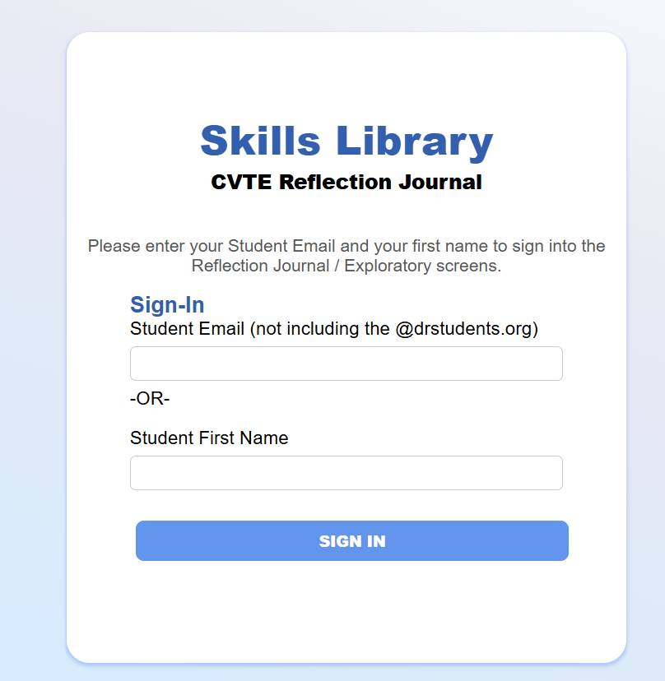
Use the shortcut link skillsdr.me
or the full link at https://skillslibrary-ctei.com/studentpages. An individualized link is also provided
via the emails.
You will initially sign in with your name and email, and then later be prompted to set your own password.

Slide 15
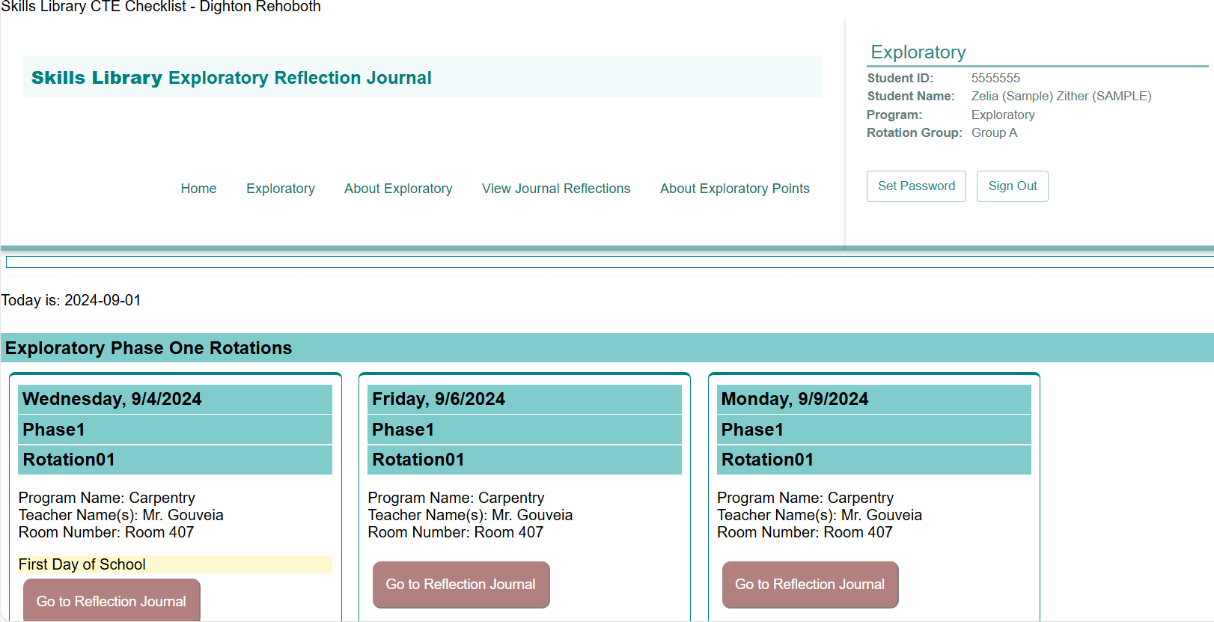
The Exploratory screen includes your personalized schedule. For each day of the program, you will see the date, time, program name, teacher name and room number.
From the signin page and dashboard, You can click EXPLORATORY to see your schedule.

Slide 16
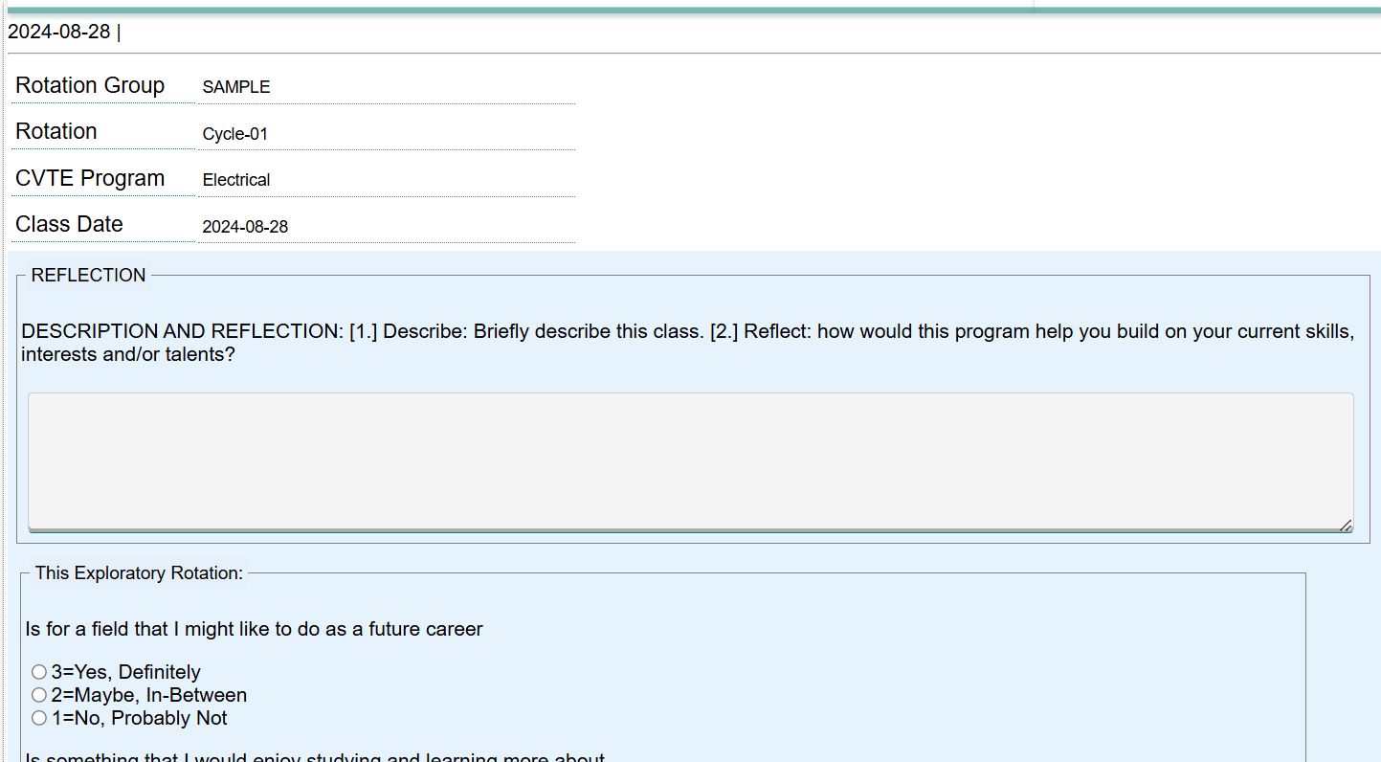
This is the reflection screen. You can write and SAVE your reflections for each session.

Slide 17
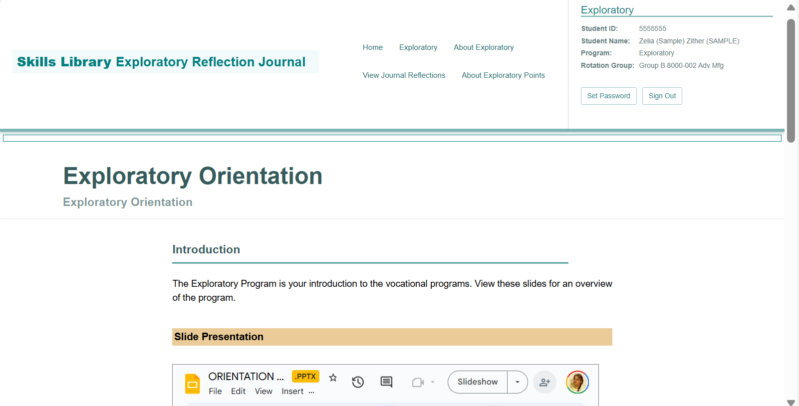

Your can view other items as well, including:
this Exploratory Orientation slide show and notes about the Exploratory Program;
your Exploratory grade; and
your reflection journal entries.
Program choice forms are posted near the completion of the first Exploratory phase.

Slide 18
Discussion & Questions

